Slide 1
MATH1123
Calculus for Science and Engineering
*

Slide 2

*

Slide 3
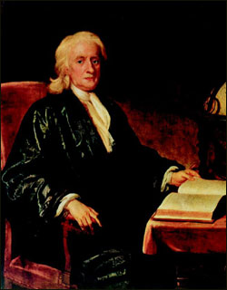
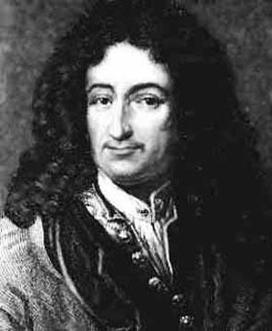
They invented Calculus!
Sir Isaac Newton (1642-1727)
Gottfried Wilhelm von Leibniz
(1646-1716)
*

Slide 4
What is Calculus all about?
Calculus is the study of change, or to be more precise, changing quantities.
The two key areas of Calculus are Differential Calculus and Integral Calculus.
The big surprise is that these two seemingly unrelated areas are actually connected via the Fundamental Theorem of Calculus.
*

Slide 5
Why do I have to take Calculus?
The obvious answer is: It is required for your major!
If you choose a career path that requires any level of mathematical sophistication (such as Engineering, Economics or any branch of Science), you will need Calculus.
*

Slide 6
What can I do to maximize my chances for success?
Do math problems by yourself.
*

Slide 7
Some Suggestions
Bring your questions when you take lecture. Questions could be found by preview.
Review what you have studied as soon as possible after lecture. Textbook should be read carefully.
Try your best to attend all lectures and tutorial class.
*

Slide 8
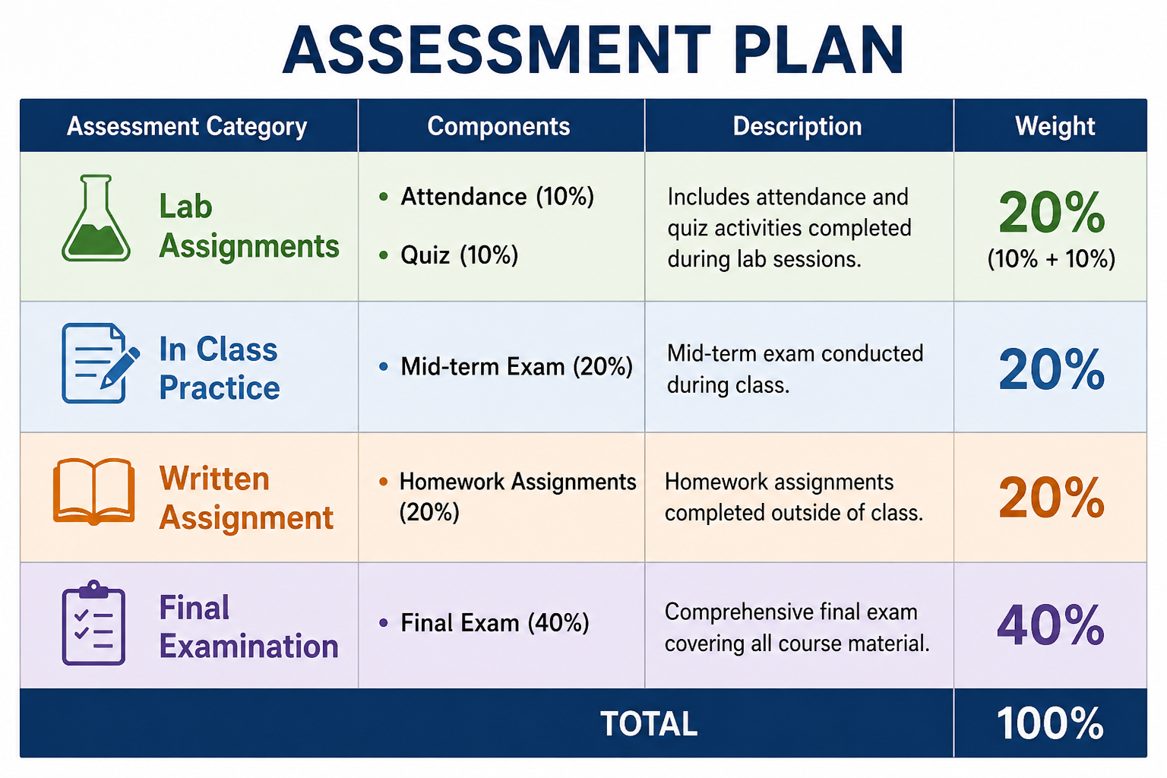
*

Slide 9
Score System
Letter Grade | Academic Performance | GPA (Grade Per Unit)
A | Excellent | 4.00
A- | Excellent | 3.67
B+ | Good | 3.33
B | Good | 3.00
B- | Good | 2.67
C+ | Satisfactory | 2.33
C | Satisfactory | 2.00
C- | Satisfactory | 1.67
D | Marginal Pass | 1.00
F | Fail | 0.00
*

Slide 10
Some notices on this Course
Assignments must be handed in before the deadline.
up to 24 hours after the deadline, the assignment is only worth 80%.
More than 24 hours and up to 48 hours after the deadline, the assignment is only worth 60%
More than 48 hours after the deadline - your assignments will not be accepted!
For the mid-term test and final examination, you can
not bring anything except some stationeries and water! Mobiles are not allowed.
For the final examination, we can not tell you the score before the AR inform the official results. If you have any question on the score, you can check the marked sheet via AR.
*

Slide 11
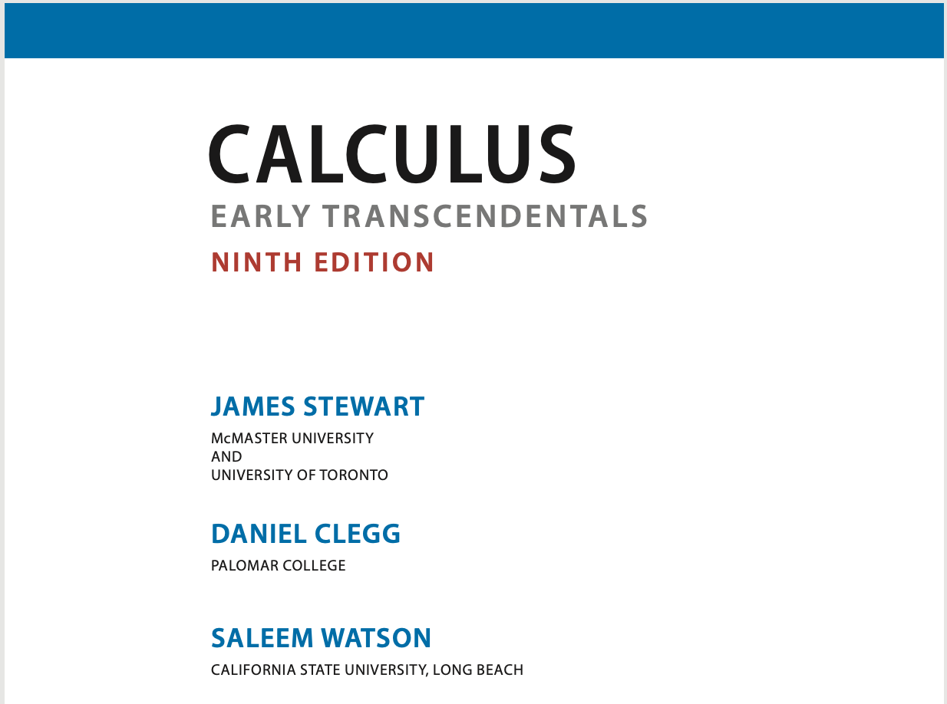
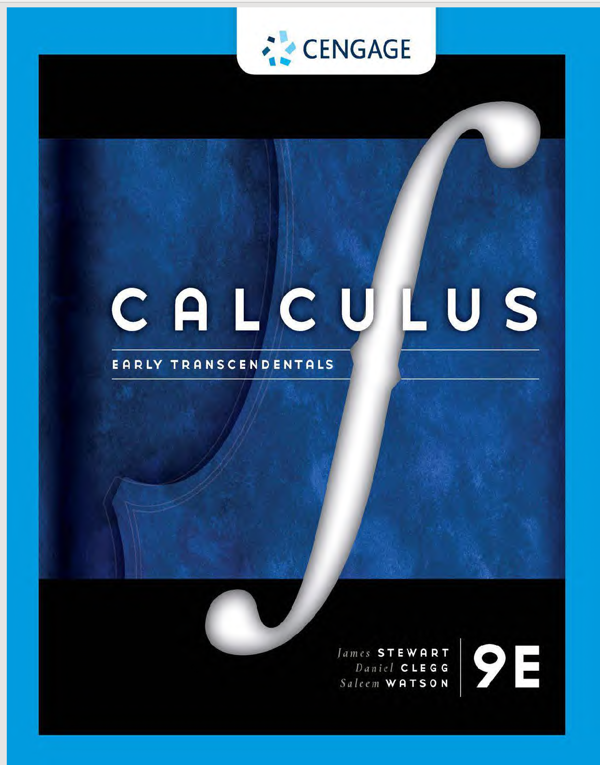
TEXTBOOK

Slide 12
References
S. Salas, E. Hille and G.J. Etgen, Calculus, One and Several Variables, 8th edition, John Wiley & Sons, 1999.
L.D. Hoffmann, G.L. Bradley, Calculus, for Business, Economics and the Social and Life sciences, 9th edition, McGraw Hill, 2004.
Calculus-Early Transcendental Functions, 3rd Edition，Smith and Minton, 2007, McGraw Hill, International Edition
D. Hughes-Hallett, A.M. Gleason, W.G. McCallum et al., Calculus, Single and Multivariable, 2nd edition, Wiley, 1998.

